Slide 1
A/B Testing Analysis Report

Slide 2
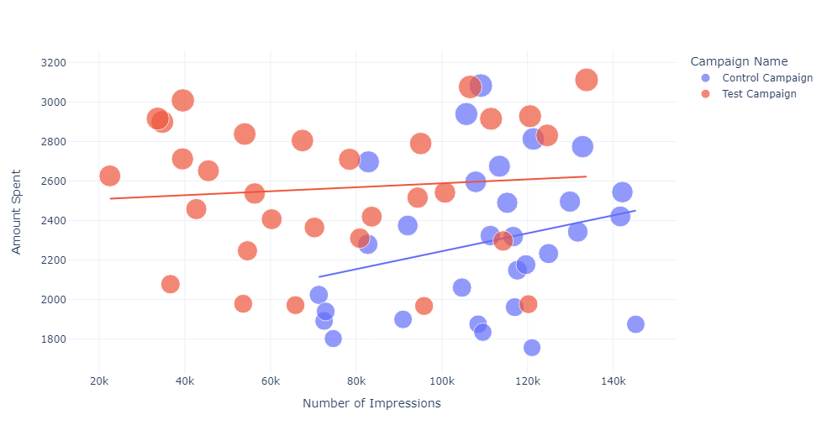

Relationship Between Impressions and Amount Spent
The control campaign resulted in more impressions according to the amount spent on both campaigns.

Slide 3
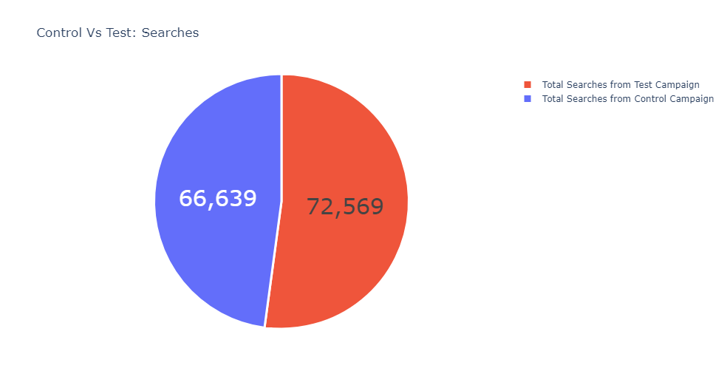
Number of Searches Performed on the Website
The test campaign resulted in 8.5% more searches on the website.

Slide 4

Number of Website Clicks
The test campaign wins in the number of website clicks with 12.5% more clicks.

Slide 5
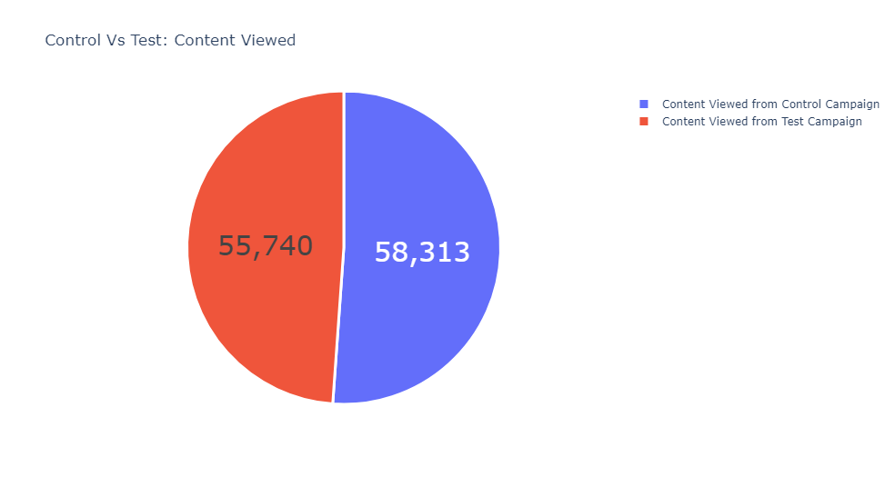
Amount of Content Viewed
The audience of the control campaign viewed 4.5% more content than the test campaign. Although there is not much difference, as the website clicks of the control campaign were low, its engagement on the website is higher than the test campaign.

Slide 6
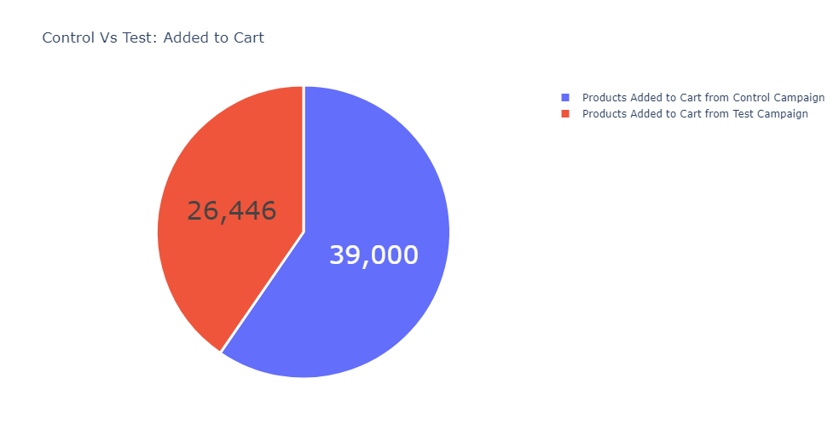
Number of Products Added to Cart
Despite low website clicks, more products were added to the cart from the control campaign, which is 38.3% higher than test campaign.

Slide 7
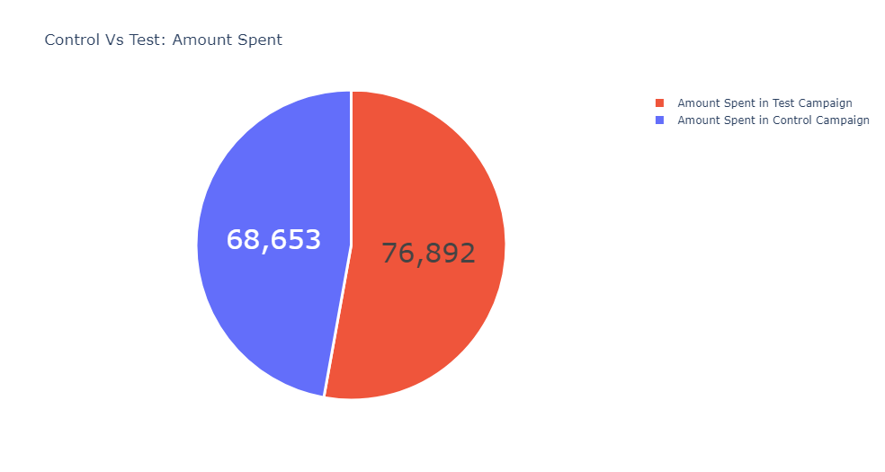
Amount Spent on Both Campaigns
The amount spent on the test campaign is 11.3% higher than the control campaign. But as we can see that the control campaign resulted in more content views and more products in the cart, the control campaign is more efficient than the test campaign

Slide 8
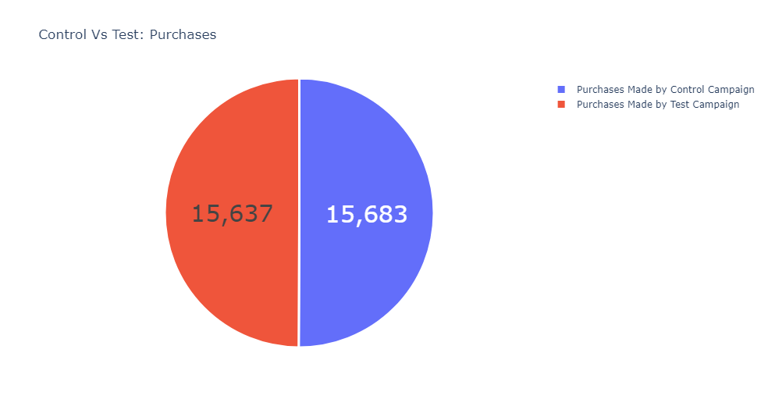
Purchases Made by Both Campaigns
There’s only a difference of around 1% in the purchases made from both ad campaigns. As the control campaign resulted in more sales in less amount spent on marketing, the control campaign wins here!

Slide 9
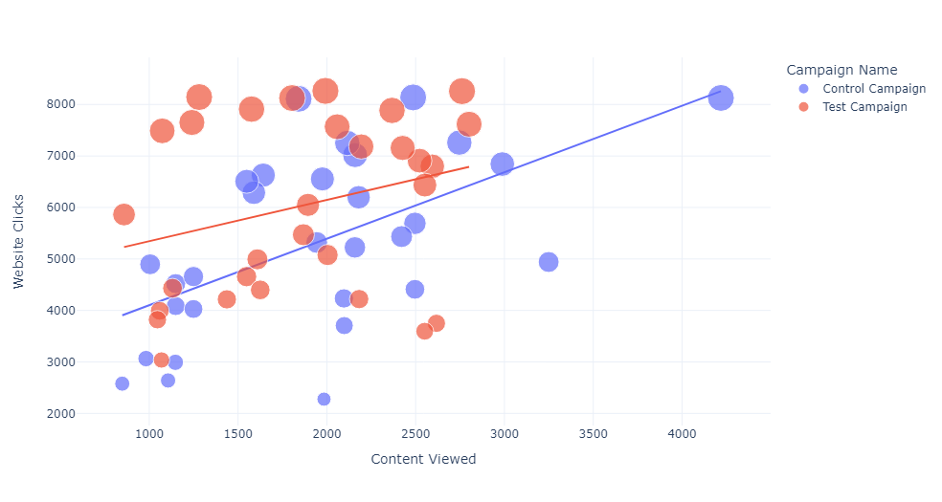
Clicks vs. Content Viewed
The website clicks are higher in the test campaign, but the engagement from website clicks is higher in the control campaign. So, the control campaign wins!

Slide 10
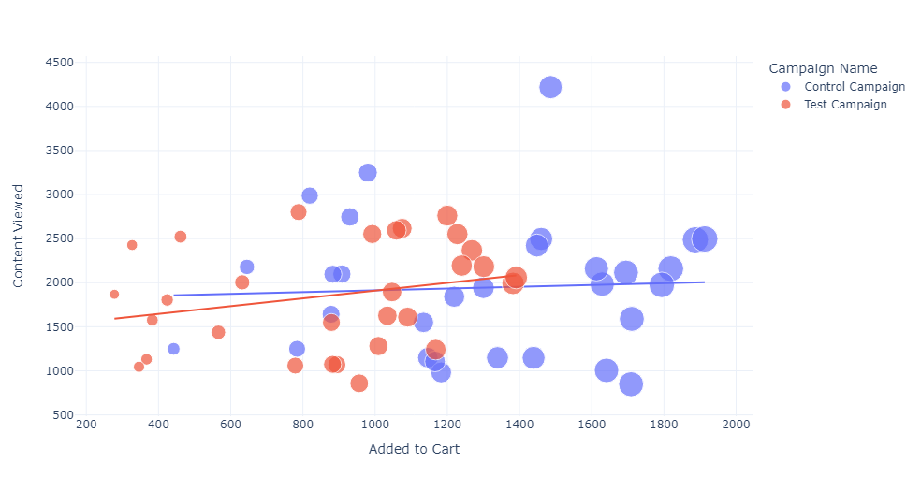
Content Viewed vs. Products Added to Cart
Again, the control campaign wins!

Slide 11
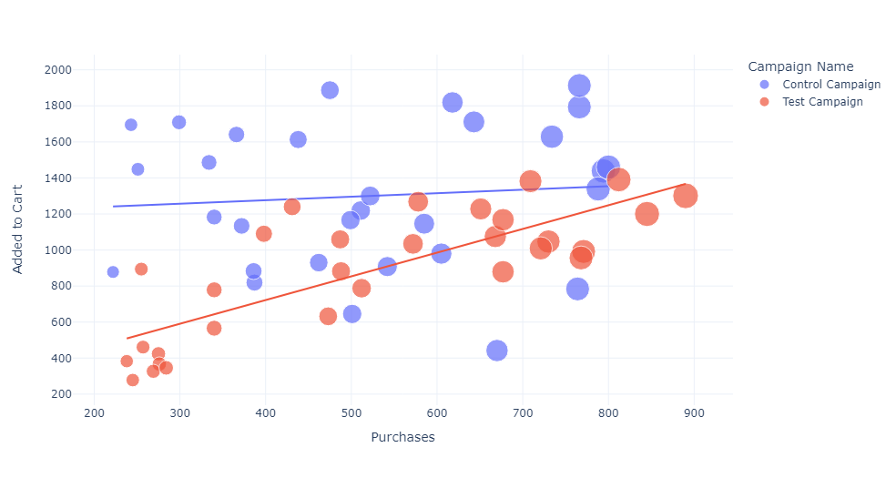
Products Added to Cart vs. Sales
Although the control campaign resulted in more sales and more products in the cart, the conversion rate of the test campaign is higher.

Slide 12
Conclusion
From the above A/B tests, we found that the control campaign resulted in more sales and engagement from the visitors. More products were viewed from the control campaign, resulting in more products in the cart and more sales. But the conversion rate of products in the cart is higher in the test campaign. The test campaign resulted in more sales according to the products viewed and added to the cart. And the control campaign results in more sales overall. So, the test campaign can be used to market a specific product to a specific audience, and the control campaign can be used to market multiple products to a wider audience.

